Slide 1
Chapter 1
The Foundations: Logic and Proofs
1.1 Propositional Logic
1.2 Applications of Propositional Logic
1.3 Propositional Equivalences
1.4 Predicates and Quantifiers
1.5 Nested Quantifiers
1.6 Rules of Inference
1.7 Introduction to Proofs
1.8 Proof Methods and Strategy

Slide 2

Predicate
【Definition】A predicate (propositional function) is a statement that contains variables. Once the values of the variables are specified, the function has a truth value.
: n-place (n-ary) predicate
Examples
  P(x)=“x>3”
  Q(x,y)=“x is the best player of team y”
  R(x,y,z)=“x+y=z”

Slide 3
Predicate
Examples
  Let P(x) denote the statement "x > 0." What are the truth values of P(-3), P(0) and P(3)?
  P(-3)=“-3>0” F
  P0)=“0>0” F
  P(3)=“3>0” T
  Let Q(x, y) denote the statement “x < y.” What are the truth values of Q(4, 3) and Q(2, 7) ?
  Q(4, 3) =“4 < 3” F
  Q(2, 7) = “2 < 7” T

Slide 4
Quantifiers
Quantifications
  Every computer connected to the university network is functioning properly.
  Students in this class are smart.
Universal quantification
Existential quantification
Predicate logic (calculus): the area of logic that deals with predicate and quantifiers.

Slide 5
Universal Quantification
【Definition】A universal quantification of P(x), denoted by ∀ x P(x), is the statement “P(x) for all values of x in the domain. ”
∀ : universal quantifier
Domain (domain of discourse / universe of discourse): range of the possible values of the variable x
An element for which P(x) is false is called a counterexample of ∀ x P(x)
Example:
Let P(x) be the statement “x>0.” In the domain of all integers, x= -1 is a counterexample for ∀ x P(x).

Slide 6
Universal Quantification
Many ways to express universal quantification:
  For all
  For every
  All of
  For each
  Given any
  For arbitrary
  For any

Slide 7
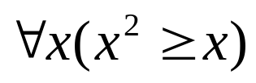
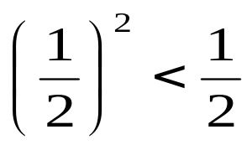
Universal Quantification
Examples:
What is the truth value of if the domain consists of all real numbers? What is the truth value of this statement if the domain consists of all integers?
Solution:
  If the domain consists of all real numbers.
  Because , is false
  If the domain consists of all integers.
  is true

Slide 8


Universal Quantification
Examples:
Express the following statement as a universal quantification: “All lions are fierce.”
Solution:
Let Q(x) denote the statement “x is fierce”.
  Assuming that the domain is the set of all lions.
  Assuming that domain is the set of all creatures.
Let P(x) denote the statement “x is a lion”.

Slide 9




Universal Quantification
Examples:
What is the truth value of ∀ x P(x), where P(x) is the statement “x<3” and the domain is ?
Solution:
Because P(3), which is the statement “3<3,” is false,
it follows that ∀ x P(x) is false.
Remark: Given the domain as ,

Slide 10
Existential Quantification
【Definition】An existential quantification of P(x), denoted by ∃ x P(x), is the statement “There exists an element x in the domain such that P(x). ”
∃ : existential quantifier
Other expressions:
For some x P(x)
There is an x such that P(x)
There is at least one x such that P(x)

Slide 11


Existential Quantification
Examples:
Express the following statement as an existential quantification. “Some real numbers are rational numbers. ”
Solution:
Let Q(y): y is a rational number
Assuming that the domain is the set of all real numbers.
(2) Assuming that the domain is the set of all complex numbers. Let R(y): y is a real number

Slide 12


Existential Quantification
Examples:
What is the truth value of ∃ x P(x), where P(x) is the statement “x<3” and the domain is ?
Solution:
Because P(1), which is the statement “1<3,” is true,
it follows that ∃ x P(x) is true.
Remark: Given the domain as ,

Slide 13
Quantifiers
Statement | When true? | When false?
∀x P(x) | P(x) is true for every x. | There is an x for which P(x) is false.
∃x P(x) | There is an x for which P(x) is true. | P(x) is false for every x.
Other Quantifiers
  Uniqueness quantifier: ∃! or ∃₁
  ∃! P(x)or ∃₁P(x): There exists a unique x such that P(x) is true.

Slide 14
Quantifiers with Restricted Domains
Example: What do the statements ∀ x<0 ( x²>0), ∃ y>0 (y²=2) mean, where the domain in each case consists of the real numbers?
Solution:
∀ x<0 ( x²>0)
For every real number x with x<0, x²>0
∃ y>0 (y²=2)
There exists a real number y with y>0 such that y²=2

Slide 15
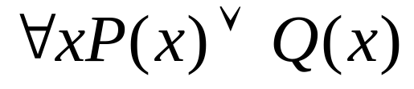
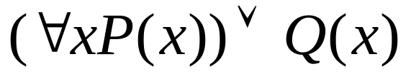
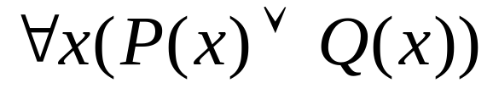
Precedence of Quantifiers
The quantifiers ∃ and ∀ have higher precedence than all logical operators from propositional calculus.
Example:
√
X

Slide 16
Binding Variables
Bound variable: a variable is bound if it is quantified.
Free variable: a variable neither quantified nor specified with a value
All the variables in a propositional function must be quantified or set equal to a particular value to turn it into a proposition.
Scope of a quantifier: the part of a logical expression to which the quantifier is applied
Examples
∃x (x+y)=1
∃x (P(x) ∧ Q(x)) ∨ ∀x R(x)

Slide 17
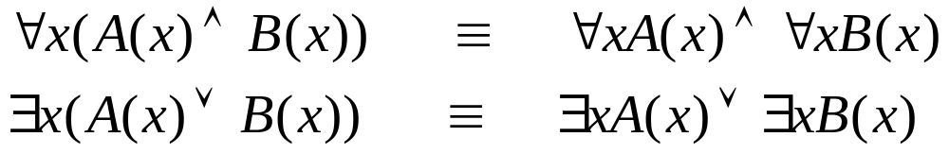
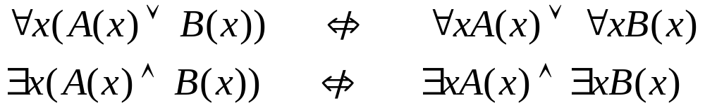
Logical Equivalences Involving Quantifiers
【Definition】 Statements involving predicates and quantifiers are logically equivalent iff they have the same truth
      for every predicate substituted into these statements and
      for every domain of discourse used for the variables in the expressions.
S≡T : two statements S and T involving predicates and quantifiers are logically equivalent.
Examples (Assuming all variables are in the same domain):

Slide 18
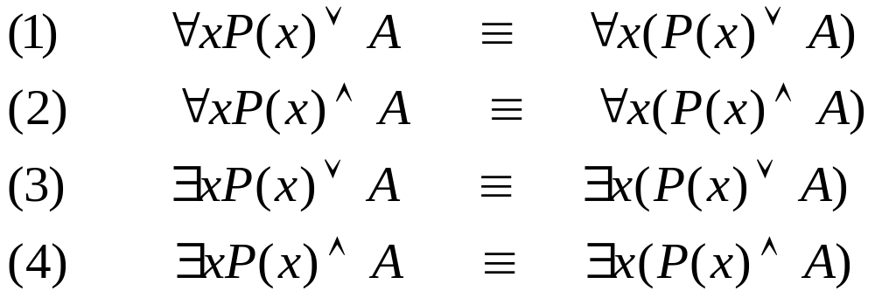



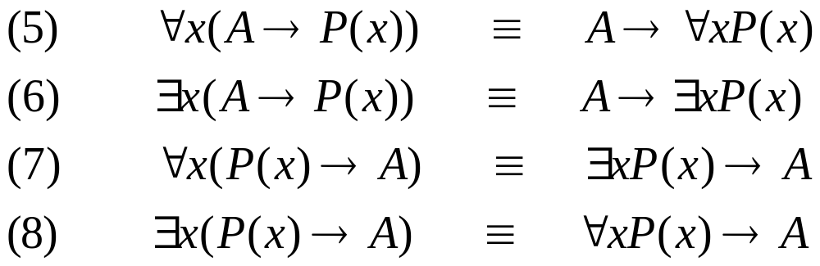



Logical Equivalences Involving Quantifiers
x is not occurring in A.
Proof:
Proof:

Slide 19
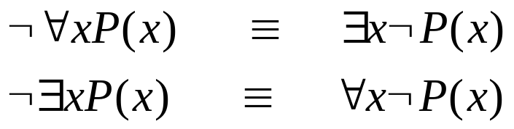




Negating Quantified Expressions
De Morgan’s laws for quantifiers
Example
Let P(x) be the statement “Student x has taken calculus.” Assume the domain consists of the students in our class.
  Express ∀x P(x) and its negation.
  Express ∃x P(x) and its negation.
Solution:
∀x P(x) : Every student in our class has taken calculus.
: There is a student in our class who has not taken calculus. ( )
∃ x P(x): There is a student in our class who has taken calculus.
: Every student in our class has not taken calculus. ( )

Slide 20
De Morgan’s Laws for Quantifiers
Negation | Equivalent Statement | When is Negation True? | When False?
¬∃x P(x) | ∀x ¬P(x) | P(x) is false for every x | There is an x for which P(x) is true
¬∀x P(x) | ∃x ¬P(x) | There is an x for which P(x) is false | P(x) is true for every x

Slide 21
Translating from English into Logical Expressions
Goal: To produce a logical expression that is simple and can be easily used in subsequent reasoning.
Steps:
  Clearly identify the appropriate quantifier(s)
  Introduce variable(s) and predicate(s)
  Translate using quantifiers, predicates, and logical operators
There can be many ways to translate a particular sentence.

Slide 22
Example
C(x): x is a CS student, E(x): x is a Math student, S(x): x is a smart student, and the domain consists of all students in our class
1) Everyone is a CS student.
2) Nobody is a Math student.
3) All CS students are smart students.
4) Some CS students are smart students.
∀x C(x)
∀x ¬ E(x) or ¬ ∃x E(x)
∀x (C(x) → S(x))
∃x (C(x) ∧ S(x))

Slide 23
Example
C(x): x is a CS student, E(x): x is an Math student, S(x): x is a smart student, and the domain consists of all students in our class
5) No CS student is an Math student.
  If x is a CS student, then that student is not a Math student.
  ∀x (C(x) → ¬ E(x))
  There does not exist a CS student who is also a Math student.
  ¬ ∃x [C(x) ∧ E(x)]
6) If any Math student is a smart student then he is also
a CS student.
  ∀x ((E(x) ∧ S(x)) → C(x))

Slide 24
Examples from Lewis Carroll [1]
“All lions are fierce”
“Some lions do not drink coffee”
“Some fierce creatures do not drink coffee”
Let P(x), Q(x), and R(x) be the statements “x is a lion”, “x is fierce”, and “x drinks coffee”, respectively. Assume the domain consists of all creatures.
∀x (P(x) → Q(x))
∃x (P(x) ∧ ¬ R(x))
∃x (Q(x) ∧ ¬ R(x))

Slide 25
Examples from Lewis Carroll [2]
“All hummingbirds are richly colored”
“No large birds live on honey”
“Birds that do not live on honey are dull in color”
“Hummingbirds are small”
Let P(x), Q(x), R(x), and S(x) be the statements “x is a hummingbird”, “x is large”, “x lives on honey”, and “x is richly colored”, respectively. Assume the domain consists of all birds.
∀x (P(x) → S(x))
¬∃x (Q(x) ∧ R(x))
∀x (¬R(x) → ¬S(x))
∀x (P(x) → ¬Q(x))

Slide 26
Translating from English into Logical Expressions
Tips
  All S(x) are O(x) : ∀x (S(x) → O(x))
  No S(x) are O(x) : ∀x (S(x) → ¬ O(x))
  Some S(x)’s are O(x) : ∃x (S(x) ∧ O(x))
  Some S(x) are not O(x) : ∃x (S(x) ∧ ¬ O(x))
Where S(x) and O(x) are propositional functions of variable x

Slide 27
Homework
Due on Mar. 16 (Tues.)
Sec. 1.4
Ver. 7
6(c,d,e,f), 9(b,d), 20(e), 24(b,d), 40(b), 44, 49(a), 60
Ver. 8
6(c,d,e,f), 9(b,d), 20(e), 24(b,d), 42(b), 46, 51(a), 62

Slide 28
Chapter 1
The Foundations: Logic and Proofs
1.1 Propositional Logic
1.2 Applications of Propositional Logic
1.3 Propositional Equivalences
1.4 Predicates and Quantifiers
1.5 Nested Quantifiers
1.6 Rules of Inference
1.7 Introduction to Proofs
1.8 Proof Methods and Strategy

Slide 29
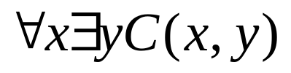

Nested Quantifiers
A statement can have multiple variables
Example:
Let C(x,y) denote “x has taken course y,” where the domain of x and y consist of all ZJU students and all CS courses, respectively. We may construct the following propositions:
Every student at ZJU has taken some CS course.
Some student at ZJU has taken all CS courses.
【Definition】Two quantifiers are nested if one is within the scope of the other.

Slide 30

Translating from Nested Quantifiers into English
Examples
Translate the statement into English, where C(x) is "x has a computer," F(x,y) is "x and y are friends," and the domain for both x and y consists of all students at ZJU.
Solution:
For every student x at ZJU, x has a computer or there is a student y such that y has a computer and x and y are friends.

Every student at ZJU has a computer or has a friend who has a computer.

Slide 31
Translating from Nested Quantifiers into English
Examples
Translate the following statement into English, where F(x,y) means x and y are friends and the domain for x, y, and z consists of all students at ZJU.
Solution:
There is a student x such that for all students y and all students z other than y, if x and y are friends and x and z are friends, then y and z are not friends.

There is a student none of whose friends are also friends with each other.

Slide 32
Translating English into Logical Expressions
Examples
Express the statement “Everyone has exactly one best friend” as a logical expression with a domain consisting of all people.
Solution:
Rewrite the original statement as
“For every person x , x has exactly one best friend.”
“There is a person y who is the best friend of x, and furthermore, that for every person z, if z is not y, then z is not the best friend of x.”
Let B(x, y) be the statement “y is the best friend of x.”

Slide 33

Translating English into Logical Expressions
Examples
Express the statement “If a person is female and is a parent, then this person is someone’s mother” as a logical expression with a domain consisting of all people.
Solution:
Rewrite the original statement as
“For every person x, if x is female and x is a parent, then there exists a person y such that x is the mother of y.”
Let F(x): “x is female,”
P(x): “x is a parent,”
M(x, y): “x is the mother of y.”

Slide 34
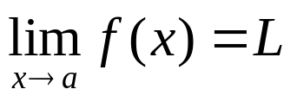
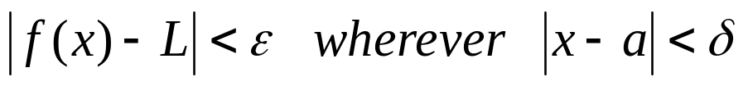
Translating English into Logical Expressions
Examples
Express the definition of a limit using quantifiers.
Solution:
The definition of the limit is:
“For every real number ε>0 there exists a real number δ>0 such that ”
Assume the domain for the variables ε, δ, and x consist of
all real numbers, we have

Slide 35



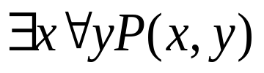
The Order of Quantifiers
The order of nested quantifiers matters if quantifiers are of different types
is not the same as
Example:
Assume P(x,y) denote “x loves y,” where the domain for variables x and y consists of all people. Translate the following expressions into English
There is someone who loves everyone.
Everybody is loved by somebody.

Slide 36
Quantifications of Two Variables
Statement | When True? | When False?
∀x ∀y P(x, y) ∀y ∀x P(x, y) | P(x, y) is true for every pair x, y. | There is a pair x, y for which P(x, y) is false.
∀x ∃y P(x, y) | For every x there is a y for which P(x, y) is true. | There is an x for which P(x, y) is false for every y.
∃x ∀y P(x, y) | There is an x for which P(x, y) is true for every y. | For every x there is a y for which P(x, y) is false.
∃x ∃y P(x, y) ∃y ∃x P(x, y) | There is a pair x, y for which P(x, y) is true. | P(x, y) is false for every pair x, y.

Slide 37
Negating Nested Quantifiers
Negating nested quantifiers by successively applying the rules for negating statements involving a single quantifier
Examples:
Express the negation of the statement ∀x ∃ y (xy=1) so that no negation precedes a quantifiers.
Solution:
¬(∀x ∃ y (xy=1))
≡ ∃ x(¬ ∃ y (xy=1))
≡ ∃ x∀ y (¬ (xy=1))
≡ ∃ x∀ y (xy≠1)

Slide 38
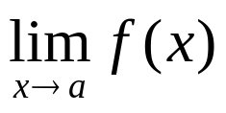
Negating Nested Quantifiers
Negating nested quantifiers by successively applying the rules for negating statements involving a single quantifier
Examples:
Use quantifiers and predicates express the fact that
does not exist.
Solution:

Slide 39
Homework
Due on Mar. 16 (Monday)
Sec. 1.5
Ver. 7 & Ver. 8
6(e, f), 12(d, h, k, n), 14(c, d, e, f), 24(a, d), 32(d), 34, 38(b, d), 42

Slide 40
Functionally Complete
【Definition】 A set of logical operators is called functionally complete if every compound proposition is logically equivalent to a compound proposition involving only this set of logical operators.
∧, ∨, and ¬ form a functionally complete set of operators.
∧ (∨) and ¬ form a functionally complete set of operators.

Slide 41
Propositional Normal Forms
Literal: p or ¬p
【Definition】 Disjunctions (conjunctions) with one or more literals as disjuncts (conjuncts) are called disjunctive (conjunctive) clauses. Disjunctive and conjunctive clauses are simply called clauses.
Examples:
  q ∨ r
  ¬ q ∧ p
  p ∧ q ∨ r
Disjunctive clause
Conjunctive clause
Not a clause

Slide 42
Conjunctive Normal Form (CNF)
【Definition】A conjunction with one or more disjunctive clauses as its conjuncts is said to be in conjunctive normal form.
(A₁₁ ∨ … ∨ A_{1n1}) ∧ … ∧ (A_{k1} ∨ … ∨ A_{knK})
Examples:
  p ∧ (q ∨ r)
  ¬ q ∧ p
  p ∧ ((p ∧ q) ∨ r)
√
√
x

Slide 43
Disjunctive Normal Form (DNF)
【Definition】A disjunction with one or more conjunctive clauses as its disjuncts is said to be in disjunctive normal form.
(A₁₁ ∧ … ∧ A_{1n1}) ∨ …∨ (A_{k1} ∧…∧ A_{knK})
Examples:
  (p ∧ q) ∨ (p ∧¬q)
  p ∨ (q ∧ r)
  ¬p ∨ T
  ¬(p ∧ q) ∨ r
√
√
√
x

Slide 44
More Examples
DNF & CNF
p
¬p ∨ q
¬p ∧ q ∧ ¬r
¬p ∨ (q ∧ ¬r)
¬p ∧ (q ∨ ¬r) ∧ (¬q ∨ r)
DNF & CNF
DNF & CNF
DNF
CNF

Slide 45
Recall
Find a compound proposition involving the propositional variables p, q, r that is true when exactly two of p, q, and r are true and is false otherwise.
Solution:
    p ∧ q ∧ ¬r
    p ∧ ¬ q ∧ r
    ¬ p ∧ q ∧ r
    ( p ∧ q ∧ ¬r ) ∨ (p ∧ ¬ q ∧ r ) ∨ (¬ p ∧ q ∧ r)

Slide 46
How to Obtain Normal Forms
Use logical Equivalences
p → q ⇔ ¬p ∨ q
p ↔ q ⇔ (¬p ∨ q) ∧ (p ∨ ¬q)
p ↔ q ⇔ (p ∧ q) ∨ (¬p ∧ ¬q)
¬¬p ⇔ p
¬(p₁ ∧ … ∧ p_{n}) ⇔ ¬p₁ ∨ … ∨ ¬p_{n}
¬(p₁ ∨ … ∨ p_{n}) ⇔ ¬p₁ ∧ … ∧ ¬p_{n}
p ∧ (q₁ ∨ … ∨ q_{n}) ⇔ (p ∧ q₁) ∨…∨ (p ∧ q_{n}) (q₁ ∨ … ∨ q_{n}) ∧ p ⇔ (p ∧ q₁) ∨…∨ (p ∧ q_{n})
p ∨ (q₁ ∧ … ∧ q_{n}) ⇔ (p ∨ q₁) ∧ … ∧ (p ∨ q_{n}) (q₁ ∧ … ∧ q_{n}) ∨ p ⇔ (p ∨ q₁) ∧ … ∧ (p ∨ q_{n})

Slide 47
How to Obtain Normal Forms
Use logical Equivalences
By (1)–(3) we eliminate → and ↔.
By (4)–(6) we eliminate ¬, ∧, ∨, from the scope of ¬ such that any ¬ has only a literal as its scope.
By (7) we eliminate ∨ from the scope of ∧.
By (8) we eliminate ∧ from the scope of ∨.
This method leads to obtaining the disjunctive or conjunctive normal forms.

Slide 48
How to Obtain Normal Forms
Examples
Convert the following formula into a conjunctive normal form.
¬((p ∨ ¬q) ∧ ¬r)
Solution:
¬((p ∨ ¬q) ∧ ¬r)
⇔ ¬(p ∨ ¬q) ∨ ¬¬r De Morgan’s Law
⇔ ¬(p ∨ ¬q) ∨ r Double negation
⇔ (¬p ∧ ¬¬q) ∨ r De Morgan’s Law
⇔ (¬p ∧ q) ∨ r Double negation
⇔ (¬p ∨ r) ∧ (q ∨ r) Distributive law

Slide 49




How to Obtain Normal Forms
Examples
Convert the following formula into conjunctive and disjunctive normal forms.
Remark: Formulas (*) is in CNF and formulas (**) is in DNF.
Solution:

Slide 50
Full Disjunctive Normal Form
【Definition】 A minterm is a conjunction of literals in which each variable is represented exactly once.
Example:
If a Boolean function has the variables p, q, r, then
p∧ ¬q∧ r is a minterm, but p∧ ¬q and p∧ ¬p∧ r are not.
Question:
If a formula has n variables, how many minterms are there?
【Definition】 If a formula is expressed as a disjunction of minterms, it is said to be in full disjunctive normal form.
Example:
2 ^{n}

Slide 51


Transforming to Full Disjunctive Normal Form
Obtain disjunctive normal form,
Make use of negation laws and distributive laws to obtain full disjunctive normal form.
Example
Convert the following formula into full disjunctive normal form.
Solution:

Slide 52
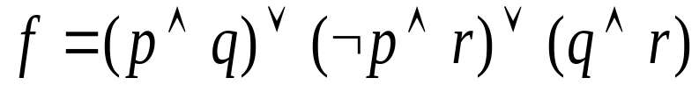
Full Disjunctive Normal Form from Truth Table
p | q | r | f
T | T | T | T
T | T | F | T
T | F | T | F
T | F | F | F
F | T | T | T
F | T | F | F
F | F | T | T
F | F | F | F

Slide 53
Full Disjunctive Normal Form from Truth Table
p | q | ¬ p ∧ ¬q | ¬ p ∧ q | p ∧ ¬q | p ∧ q
T | T | F | F | F | T
T | F | F | F | T | F
F | T | F | T | F | F
F | F | T | F | F | F
Each minterm is true for exactly one assignment.
If A and B are two distinct minterms, then A ∧ B ⇔F.
A disjunction of minterms is true only if at least one of its constituent minterms is true.

Slide 54
Full Disjunctive Normal Form from Truth Table
Example
Find the full disjunctive normal form for f given by the table.
p | q | r | f
T | T | T | T
T | T | F | F
T | F | T | T
T | F | F | F
F | T | T | F
F | T | F | F
F | F | T | T
F | F | F | F

Slide 55
Full Disjunctive Normal Form
Questions:
Using the full disjunctive normal form,
how to determine whether two statements are logical equivalent?
how to determine whether a given statement is tautology, contradiction or contingency?
how to find the assignments for which a given statement is true?

Slide 56

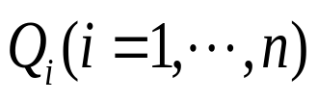

Prenex Normal Form
【Definition】A statement is in prenex normal form iff it is of the
form , where is and the
predicate B is quantifier free.
A formula with no quantifiers is regarded as a trivial case of a prenex normal form.
Examples:
  ∀xP(x) ∨ ∀xQ(x)
  ∀x∀y¬(P(x)→Q(y)
  ∀x∃yR(x,y)
  ¬∀xR(x,y)
X
√
√
X

Slide 57
Transforming to Prenex Normal Form
Any expression can be converted into a prenex normal form.
Eliminate all occurrences of → and ↔ from the formula in question;
Move all negations inward such that, in the end, negations only appear as part of literals;
Rename the variables (when necessary);
The prenex normal form can now be obtained by moving all quantifiers to the front of the formula.

Slide 58
Transforming to Prenex Normal Form
Step 1:
  A → B ⇔ ¬A ∨ B
  A ↔ B ⇔ (¬A ∨ B) ∧ (A ∨ ¬B)
  A ↔ B ⇔ (A ∧ B) ∨ (¬A ∧ ¬B)
Step 2:
  ¬¬A ⇔ A
  ¬∃xA(x) ⇔ ∀x¬A(x)
  ¬∀xA(x) ⇔ ∃x¬A(x)

Slide 59
Transforming to Prenex Normal Form
Step 3: Rename all variables in the statement
Example:
∀x(P(x)→Q(x)) ∧ ∃xQ(x) ∧ ∃zP(z) ∧ ∃z(Q(z)→R(x))
Solution:
Use y for x in ∀x, u for x in ∃xQ(x), and w for z in ∃zP(z):
∀y(P(y)→Q(y)) ∧ ∃uQ(u) ∧ ∃wP(w) ∧ ∃z(Q(z)→R(x))

Slide 60
Transforming to Prenex Normal Form
Step 4:
  A ∧ ∃xB(x) ⇔ ∃x (A ∧ B(x))
  A ∧ ∀xB(x) ⇔ ∀x (A ∧ B(x))
  A ∨ ∃xB(x) ⇔ ∃x (A ∨ B(x))
  A ∨ ∀xB(x) ⇔ ∀x (A ∨ B(x))
  ∀x∀y A(x,y) ⇔ ∀y∀x A(x,y)
  ∃x∃y A(x,y) ⇔ ∃y∃x A(x,y)
  Q₁xA(x) ∧ Q₂yB(y) ⇔ Q₁xQ₂y(A(x) ∧ B(y))
  Q₁xA(x) ∨ Q₂yB(y) ⇔ Q₁xQ₂y(A(x) ∨ B(y))

Slide 61
Transforming to Prenex Normal Form
Example: Convert the following formulas into prenex normal form.
Solution:

Slide 62
Prenex CNF and DNF
Step1: Prenex normal form
Step 2: Prenex DNF or CNF

Slide 63
HW (Due on Mar. 16)
1. Give the simplest DNF and CNF of the following statements:
1) ((p → q) ↔ (¬q → ¬p)) ∧ r
2) p ∨ (¬p ∨ (q ∧ ¬q))
3) (p ∧ (q ∧ s)) ∨ (¬p ∧ (q ∧ s))
2. Give the full DNF of the following statements:
1) (¬p ∨ ¬q) → (p ↔ ¬q)
2) (¬r ∧ (q → p)) → (p → (q ∨ r))
3) (p → (q ∧ r)) ∧ (¬p → (¬q ∧ ¬r))

Slide 64
HW (Due on Mar. 16)
3. Give the prenex normal forms of the following statements:
1) ∀x(P(x) → ∃yQ(x,y))
2) ∀x∀y((∃zP(x,y,z) ∧ ∃uQ(x,u)) → ∃vQ(y,v))
4. Give the prenex DNF and CNF of the following statements:
1) ∃xP(x) ∨ ∃xQ(x) → ∃x (P(x) ∨ Q(x))
2) ∀x∀ y (P(x) → Q(x,y)) → ∃y(P(y) ∧ ∃zQ(y,z))

